Slide 1
Creating a Culture of Engagement: Employee Engagement

Slide 2
Organizational Culture
A positive culture tends to be nurturing, democratic and progressive. When a culture is in positive mode it nurtures and values the contributions of its members; as a result ideas grow and flourish. A positive culture is flexible to change and adapts to meet the needs of its members in a dynamic and constantly changing world. With the combined energy of all its members, a positive culture can actively pursue the challenges of the future.
A negative culture tends to be oppressive and destructive. Members exploit and attack each other, suppressing creativity and communication. This exploitation results in negative reactions from those being exploited. These negative reactions show up as anarchistic behaviors with chaotic results. With the majority of its focus turned inward, the negative culture can't anticipate the future and is often surprised by it.

Slide 3
Importance of Culture
Direct link between culture and
High Performance
Employee Engagement
the level of employee engagement
Culture

Slide 4
What is Engagement
Employee Engagement is the means by which an organization seeks to build a partnership between the organization and its employees, such that:
- Employees fully understands and is committed to achieve the organization's objectives, and
- The organization respects the personal aspirations and ambitions of its employees.
A definition of a fully engaged employee
- Is intellectually and emotionally bound with the organization
- Gives 100 percent
- Feels passionately about its goals and
- Is committed to live by its values.
The employee goes beyond the basic job responsibility to delight the customers and drive the business forward
Source : OPC (UK) Ltd.

Slide 5
Commitment Levels
$$$
Internal Commitment
PERFORMANCE
External Commitment
ENGAGEMENT

Slide 6


Motivation Ladder (for employer which motivates him to do the job)
The work itself
Responsibility
Social interactions
Achievement
Recognition
Growth
Advancement
Sustained Motivation
(Internal Commitment)
Meeting Advanced Needs
Short-term Motivation
(External Commitment)
Money
Prizes
Awards
Celebrations
MOTIVATION
Price of Admission:
Covering Basic Needs
Competitive pay/benefits
Job fit
Working conditions
Relationship with supervisor

Slide 7
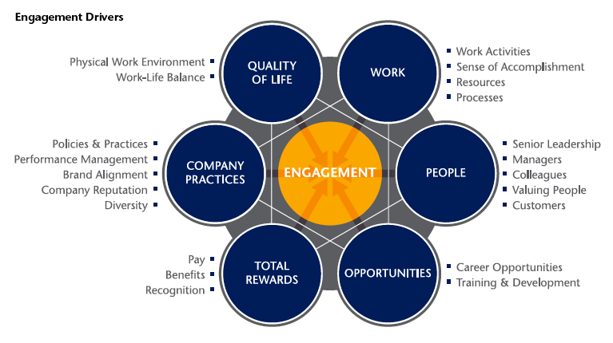
Aon Hewitt : Engagement Model
The Engagement Model goes beyond measuring people’s satisfaction with each of these drivers. The model prioritizes the areas for improvement based on their potential impact on engagement and, therefore, business performance. Another key premise of the Engagement Model is that the Engagement Drivers are interrelated; they do not operate in isolation.
Source : Aon Hewitt
Notes:
Explanation

Slide 8
Hewitt Model Of Engagement (Engagement Outcomes)
SAY
STAY
STRIVE
Behavior:
engaged employees consistently speak positively about the organization to co–workers, potential employees and customers
EOS Questions:
Given the opportunity, I tell others great things about working here
I would not hesitate to recommend this organization to a friend seeking employment
Behavior:
engaged employees have an intense desire to be a member of the organization
EOS Questions:
It would take a lot to get me to leave this organization
I rarely think about leaving this organization to work somewhere else
Behavior:
engaged employees exert extra effort and engage in behaviors that contribute to business success
EOS Questions:
This organization inspires me to do my best work every day
This organization motivates me to contribute more than is normally required to complete my work
Notes:
/eos (employee Opinion Survey)

Slide 9
Key Benefits of Employee Engagement
Better Performance - Engaged employees work smarter, not harder. They keep looking for ways to improve performance at their workplace. This means more sales, lower costs, better quality and innovative products.
Better Communication - Engaged employees communicate – they share information with colleagues, they pass on ideas, suggest and advice and they speak up for the organization. This leads to better performance, greater innovation and happier customers.
Greater Customer Satisfaction – Engaged employees go out of their way to meet customers’ needs. Customers aren’t slow to notice and this leads to higher levels of repeat business, at a good cost.
Better Team Working - Employee engagement is about increasing the employees connection with the principles, strategies, processes, culture and purpose of the organization. It is a matter of commitment and encouragement. It is a matter of focusing on business results, and the employees having a clear sense of responsibility for delivering on the business agenda.
Greater Commitment - Engaged employees care about the future of the organization they work for, they feel proud to work for their company and they get on better each day with their colleagues.
Lower Employee Turnover and Greater Ability to Recruit Great People – Higher engagement leads to low attrition, they actively seek out new people who they believe can help the company get even better.

Slide 10
Gallup Study – Q12
The Gallup Q12 survey helps companies understand how engaged their employees are. Engagement means how much employees care about their work and the company. The survey found 12 important things that make employees feel engaged.
The engagement index slots people into one of three categories:
Engaged: They love their work and help the company succeed.
Not Engaged: They're just going through the motions, not really caring much.
Actively Disengaged: They're not happy and might even make things worse for others.

Slide 11
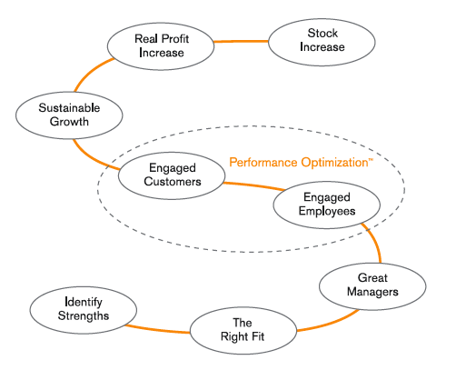
Gallup Study : Importance of Employee Engagement on Organization Economics
What the best organizations do differently?
Strategy
Accountability & Performance
Communication
Development
Source : Gallup Inc. Employee Engagement Overview
Notes:
Strategy
World-class organizations develop a formula for success by looking objectively and rigorously at the business problems they face and by focusing on finding the right employees and keeping them engaged.
For these organizations, an employee engagement strategy is not only fundamental to the way they do business, it is critical to their success.
Accountability and Performance
The top-driven companies focus on outcomes. They define and rigorously measure success at every level in the organization. These measurements ultimately help focus each person, team, department, and business unit on driving performance and results.
Communication
Within the best performing organizations there is a cultural alignment between the employees and the company, paired with a strategic alignment between activities and company goals. These organizations use their corporate communication touch points to reinforce their commitments to employees and customers.
Development
As the struggle for talent intensifies, organizations face a continual challenge to build and grow their leadership capacity. The world’s top-performing companies have comprehensive leader and manager development programs, but they also go one step further — these programs are performance-driven and incorporate a comprehensive succession plan throughout the organization. They make it priorities to not only identify leadership potential, but also to focus intently on the creation of developmental paths for current and future managers and leaders.

Slide 12
Gallup Study : Importance of Employee Engagement on Organization Economics
1. Strategy: The best organizations succeed by solving problems and keeping their employees engaged. Employee engagement is vital for their success.
2. Accountability & Performance: Successful companies focus on results. They measure success at every level to keep everyone focused on driving performance.
3. Communication: Great companies have employees and the company working together towards the same goals. They use communication to remind everyone of their commitments to employees and customers.
4. Development: The best leader are not only have leadership programs but also focus on performance and planning for future leaders. They make sure to identify and develop potential leaders within the organization.
Notes:
to learn and grow?

Slide 13
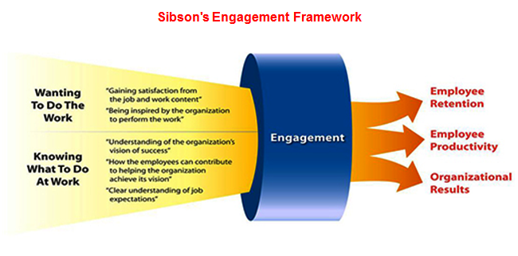
Sibsons: Engagement Framework
Source : Sibson

Slide 14
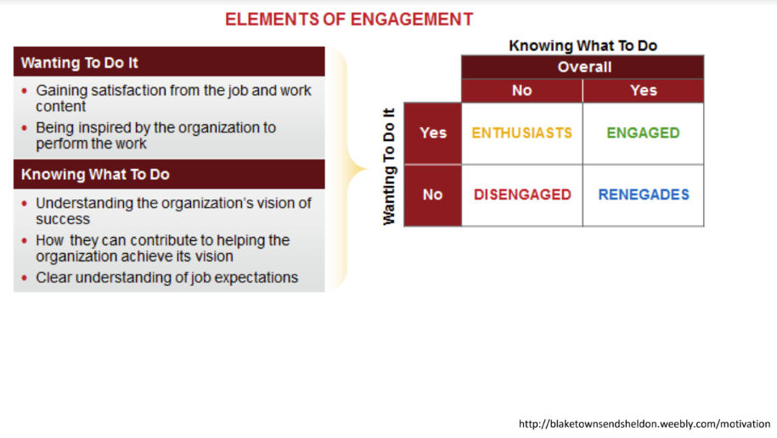
Matrix based on Sibsons: Elements of Engagement
Notes:
Engaged: know what to do and want to do it
Enthusiasts: don’t know what to do, but want to do it
Disengaged: don’t know what to do and don’t want to do it
Renegades: know what to do, but don’t want to do it

Slide 15
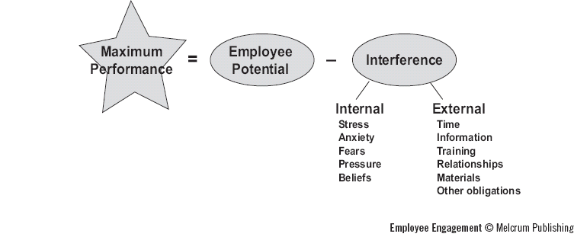
Managers Role in Driving Engagement
Brawley believes, “ To ensure long – term success, Managers need to learn, to Coach and
Develop their staff.”
Sean Brawley’s employee performance equation
Notes:
Sean Brawley, president and founder of Imaginative Coaching

